Slide 1
GIS and RS for Forest Resource Assessment
Kefyalew Sahle Hawassa University
Wondo Genet College of Forestry and Natural Resources
GIS Department

Slide 2
Unit 3. GIS & RS application in forestry management

Slide 3
Topics to be covered are the practical aspects of
Forest boundary delineation
Forest compartment mapping
Use of RS and GIS for Forest inventory
Compilation units mapping
Stratification of the mapping units
Sampling (plot distribution)
Locating sample plots
Relating inventory summary with forest compartment spatial data
Forest zoning
Forest road network mapping
Trees outside forest mapping
Thematic maps preparation using inventory summary
Synthetic Aperture Radar (SAR)sensing to support forest resource monitoring & management
Automated Individual Tree-Crown Delineation and Treetop Detection with Very-High-Resolution Aerial Imagery
LiDAR and Drone/UAV remote sensing for forest application

Slide 4
Forest boundary delineation
For definition and explanation of the forest boundary, … In this section, the practical aspect of the forest boundary data creation is discussed.
Permanent definition of forest boundaries: A basic principle of forest management is clear and permanent definition of forest boundaries , irrespective of land ownership and tenure, linked to permanent marking, surveying and mapping of boundaries.
Clear definition and subsequent surveying of boundaries are essential steps in defining and mapping forestland.
They also contribute towards achieving effective protection of a forest from degradation or loss.
It is not possible, in practice, to define the area of a forest where planned sustainable management will take place, nor to derive an annual allowable harvest in the absence of clearly defined, surveyed and mapped forest boundaries.

Slide 5
Data source for forest-boundary map preparation
Creating a new forest boundary map should involve the different stockholders. The agreed boundaries should be documented using different sources of data including
Field surveying
The agreed beacon points coordinates,
The description of the agreed lines following natural features (e.g. rivers), ridges, valleys
Parts of the boundary following the manmade features such as roads
Land marks such as hill tops, contours from topographic maps
Existing maps and /or documents
Ortho-rectified aerial photographs (ortho-rectified high resolution satellite imageries)
Baseline data such as road, river and land cover

Slide 6
Contents of forest boundary map
The boundary map should show the permanent beacon points, natural and artificial features that are part of the boundary, and contour lines mainly in mountainous terrains. The map should be complete, i.e. a closed polygon. shows an example of a forest boundary of an imaginary forest site.

Slide 7
Forest management unit boundaries
Wherever it is practicable to do so, natural geographic features should be selected to define the boundaries of a forest management unit. These include rivers, streams, shorelines, ridges and spurs. Permanent and clearly defined roads, railways and tracks may also be used. On flat country not having clearly recognizable natural features boundaries can be defined using straight lines that have a N-S, E-W orientation to enable them to be shown as true or magnetic coordinates on maps. The number of comers on straight line boundaries should be kept to a minimum.

Slide 8
Practical: Creating /updating forest boundary map
Required data are
Field protocol including sketches on topographic map and / or satellite image, GCP collected with the agreement of stakeholders, description of the boundary lines
Baseline data including river, road and land cover (if exists)
High resolution image (Give priority for recent ortho-photos. If these does not exists, use very high resolution, recent satellite imagery)
Topographic map or contour lines

Slide 9
Practical: Creating /updating forest boundary map
Steps
Create working directory / sub directories for vector data, image, raster data, and final map layouts
Import/copy the required data and data sources into the appropriate subdirectories
Create new project and set the coordinate system of the project
Add the background data into the canvas for the digitization (GCP, images, rivers, roads, topographic map (contour lines))
Create a polygon layer with the CRS approved for the region forest mapping. The attributes of the layer should at least include: forest name, area in ha, perimeter, average elevation, annual rainfall , and average slope (forestname, areaha, perimeter,elevation, rainfall, avgslope)
Change the symbol of the boundary polygon (hollow) and label with site name
Change the snapping settings to allow snapping of GCP. Depending the boundary relationship to river and/or road, allow snapping of the forest boundary digitization to these features.
Digitize the boundary following the field protocol and the boundary description: use the imagery as source of information; always snap to the GCP, river and or river where it is required
Save the editing as frequently as possible and at the end of the editing
Check for topological errors and accuracy of the shape of boundaries; edit errors
Update the area column (areha) once the boundary digitization is completed.
Prepare map layout. The map layout should have all elements of a map including main content (the forest boundary), additional contents (e.g. contour, river, road, place names, landmarks), legend. Title, north arrow, grid, foot not.

Slide 10
Forest boundary of forest site XXXX
Forest boundary in the field and on the map: The external boundary should be kept clear of bushy vegetation for a width of two meters in order that people easily recognize the boundary and to allow it to be patrolled. Trees located on a boundary should not be removed. Cost sharing between forest neighbors in the maintenance of common boundaries is desirable. This approach confirms agreement on the line of a common boundary and is cost-efficient.
Boundaries should be defined and marked using beacons which may be durable wooden poles or stone or concrete pillars painted using two contrasting colors, such as broad red and white bands. The tops of poles should be pointed, partly to shed water and also to assist with recognition. Poles should be between 1.5 meters and two meters tall. Although not all pillars need to be labelled, permanent labels should be firmly attached to those that indicate major changes in boundary direction or are triangulation points for surveys, or are "tie-in" points for internal surveys, such as compartment boundaries or various types of reserves. Trees or shrubs used for boundary definition should be fast growing and distinctively different from surrounding forest vegetation. Live markers may also be used on boundary pillars. At the comers of boundary lines direction trenches can be dug and kept clear of vegetation. Direction trenches should be 30 cm × 30 cm (wide × deep), up to 3 meters long, and should be correctly aligned to indicate the direction of the boundary

Slide 11
Forest compartment mapping
For definition and explanation of the forest compartment, refer to section the practical aspect of the forest boundary data creation is discussed.

Slide 12
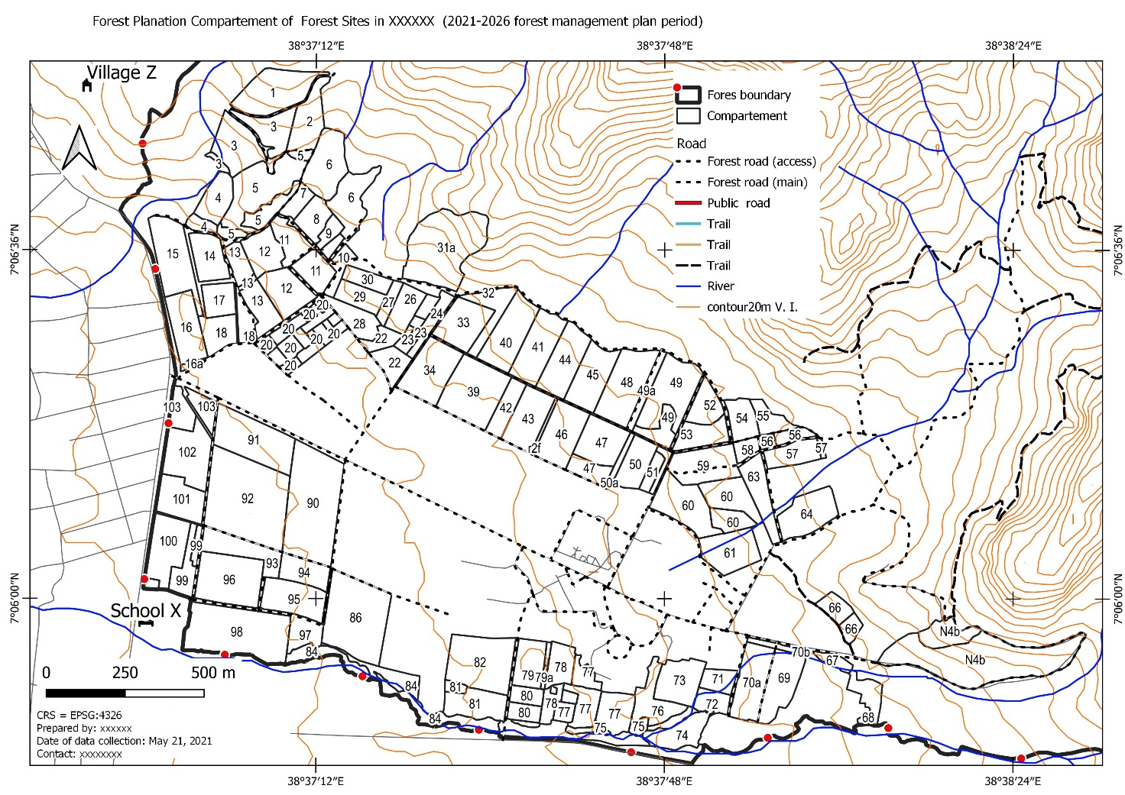
Sample forest compartment map

Slide 13
Sample of the compartments-list (area, major land use, forest crown cover, elevation and slope)
giscomp | Comp | Subcomp | Land cover 1 | Tree crown density | Area (ha) | Slope (%) | Elevation (m a.s.l.)
1b | 1 | B | Plantation forest | Close | 8.16 | 29 | 2870
1d | 1 | D | Plantation forest | Close | 33.54 | 27 | 2840
1z | 1 | Z | Built up |  | 3.09 | 17 | 2894
2a | 2 | A | Plantation forest | Close | 25.78 | 21 | 2882
2b | 2 | B | Plantation forest | Close | 18.14 | 29 | 2845
2c | 2 | C | Plantation forest | Close | 9.67 | 25 | 2766

Slide 14
Procedure for boundary and compartment map preparation
Approaches for creating the forest boundaries are shown in. The type of approach to be selected depends on the availability of the data sources.
Priority is given to existing map followed by the use of exiting GPS data.
The use of more recent ortho-photo is highly advised if available, which is not available for most parts of the country. Recent and very high resolution image can be used if the aforementioned approaches are not applicable for a given area.
The last approach is to use moderate resolution images for creating the forest boundary.

Slide 15
Practical: Creating /updating forest compartment map
Refer to the praccal session discussion notes

Slide 16
Use of RS and GIS for Forest inventory
write a report after the parctcal

Slide 17
RS and GIS
Remote-sensing data, image access solutions, and GIS provide opportunities for integrated analysis of spatial data and product development. The interactions of these components have been summarized by Wilkinson (1996):
Remote-sensing data can be used as input data for analysis within a GIS.
GIS can provide ancillary data for improved remote-sensing analysis for discrimination of forest types and land-cover and land-use classes.
The application of remote sensing and other spatial data within a GIS provides capabilities for modeling and scenario analysis.

Slide 18
Inventory

Slide 19
Inventory by compartments
Inventory by compartments is the method typically used for acquiring data for traditional forest management planning purposes. It is based on the concept of the forest stand, which is traditionally defined as a geographically contiguous parcel of land whose site type and growing stock is homogenous. In this context, compartment can almost be considered a synonym for forest stand, but a compartment must be also a suitable cutting unit or treatment unit for silvicultural measures and need not necessarily be as homogenous as a forest stand.

Slide 20
Inventory by compartments
Detailed forest management plans cannot be produced without compartment-wise estimates of site characteristics and growing stock and without silvicultural treatment proposals for each compartment. The latter must be made within the field inventory, because otherwise the planner has no way of ensuring that in the optimum solution to the forest management planning problem every compartment will be treated silviculturally in a feasible manner.

Slide 21
Inventory by compartments
Sampling theory could be used to estimate the sample size needed to attain a certain required level of accuracy in estimates of growing stock, but if the compartments are small the sample sizes become so large that the inventories will be too expensive.
Compartments identified in the inventory

Slide 22
Delineation of the compartment
The first step in the inventory is delineation of the compartment borders using digital aerial photographs, base maps and the old inventory data.
The old inventory data are also used in the field inventory, being valuable for assessing site characteristics, for example.
In the field work, a surveyor visits every compartment, checks the compartment borders, measures 2-8 sample plots at subjectively selected locations in each compartment and makes proposals for silvicultural treatment over the next 10-year planning period.

Slide 23
Information on forest structure

Slide 24
Information on forest structure
The spatial and statistical output from a classification procedure comprises one of the major information products on forest condition available by remote sensing; generally, a second set of forestry information products is obtained by continuous variable estimation procedures.
Classification produces information on the features that are contained in the list of classes imposed on the image data; the result is typically a classification map. Continuous variable estimation produces information on features that vary continuously over the landscape depicted in imagery.

Slide 25
Information on forest structure
The result may be a map or an image in which the tones correspond to the level or value of the feature of interest and vary over the extent of the map. The process can become more complex when continuously varying forest conditions are used in the process of classification.
This is not usually a problem in conventional vegetation typing or species composition of stands; the map is derived via the usual logic of classification . But typing and compiling species composition are only two of the structural attributes of forest stands that are of interest, usually as part of a general forest inventory.

Slide 26
Some of the other forest attributes of interest might include:
Forest crown closure,
Diameter at breast height (dbh),
Volume,
Height,
Stem density
Age, and
Stage of development

Slide 27
Digital classification
Digital classification has been used less frequently when the objective is to map other forest structures, because this type of mapping resembles more the estimation of a continuous variable rather than a discrete categorization.
Classification of different density or height classes has been described, but applications of remote sensing aimed at these continuous aspects of the forest inventory have been driven largely by empirical or semiempirical model estimation.

Slide 28
Digital classification
Unlike classification, which is typically driven by a statistical understanding of what the spectral response patterns mean, such models are based more on the relationships incorporated in a fundamental understanding of the physically based radiative transfer in forests.
A plethora of such studies have been reported attempting to estimate individual forest parameters such as crown closure, basal area, or volume, as independent variables which can be predicted or estimated using a calibrated remote sensing image.

Slide 29
The general approach is to
!!!!
Establish a number of field observation sites in a forest area,
Collect forest condition information at those sites,
Acquire imagery of the sites,
Locate the sites on the image,
Extract the remote sensing data from these sites,
Develop a model relating the field and spectral data, and finally,
Use the model to predict forest parameters for all forest pixels based on the spectral data.

Slide 30
Model (RS data, inventory data)
Typically, the objective is to predict the selected field variable through model analysis, with the available remote sensing data as the dependent variables.
Then, the model is inverted to predict the independent variable (such as stand volume or density) over large areas of forest.
In other words, the spatially explicit remote sensing data are considered the predictors of the locally known field parameters so that the remote sensing image can be used to map that parameter across the image landscape.

Slide 31
Model (RS data, inventory data)
The remote sensing data are inverted to provide predictions of the desired field variables. Intuitively this seems reasonable; users are aware of the fact that the remote sensing data are dependent on the field data, not the other way around.
The common tool is model inversion; models developed through experimental or normative designs are used to describe the relationships contained within a forest/remote sensing data set. The aim is to generate new insights which can guide the field scientists and help new applications become possible.

Slide 32
When using some types of remote sensing data, and empirical models such as linear regression techniques, other difficulties arise:
Typically low dynamic range of the data; generally, higher correlations can be obtained if log transformations are applied. For example, with respect to leaf biomass, after a certain density is reached, doubling that parameter will not affect the spectral response, but a log transform can help establish linear relationships;
Extensive atmospheric and geometric corrections are needed;
Difficulty in reducing sensitivity to extraneous factors (a standard feature of the normative remote sensing approach);
Generally low spatial resolution relative to the objects under scrutiny trees, and;
Generally, small sample sizes often resulting in fewer degrees of freedom than required for extensive use.

Slide 33
Basics of forest inventory

Slide 34
The Work Phases of Forest Inventories
Definition of the inventory objectives and the information desired.
Development of the sampling design, the sampling methods, and the concept for data analysis.
Data assessment (field surveys, remote sensing data analyses, and collection of information in other data sources).
Data analyses
Publication of the results (report, table, maps).

Slide 35
Forest inventory
is described/defined in different forms by different authors, but essentially with more or less the same meaning.
is the activity of data collection that helps generating the required information base on the forest resource within an area of interest.
is a tool that provides the information about size and shape of the area as well as qualitative and/or quantitative information of the growing stock.
is the tabulated, reliable and satisfactory tree information, related to the required units of assessment in hierarchical order. It is an attempt to describe quantity, quality, and diameter distribution of forest trees and many characteristics of land upon which trees are growing.

Slide 36
Forest inventory information
Forest inventory information is obtained either from measurements of individual trees or stand.
The information may be obtained from measurements taken from ground or on remote sensed imagery (aerial photographs, satellite imagery, etc.).
Forest inventory information obtained from the entire forest is called complete or 100% inventory.
In contrast, when the measurements are taken from a representative sample of the forest it is a sampling inventory.

Slide 37
User of forest inventory information
The information requirements regarding the forest resource are as manifold as are the interests in forest as an ecosystem. Interested parties are above all decision makers and researchers in forestry and related fields.
Forest owners, forest managers and forest politicians are those who demand information about the forest resource, but also regional planners, the wood industry, conservation biologists, tourism people, etc.
When the group of actually and potentially interested parties can clearly be identified, it is straight forward to plan an inventory in a flexible manner to serve many different potentially interested experts without yet knowing all of them exactly.

Slide 38
Geographical levels of forest inventory
Forest inventories at local level
Forest inventories at national level
Forest inventory at International level

Slide 39
Types of forest inventory
Three broad classes of forest inventories can be considered based on the depth of the investigation:
Reconnaissance inventory
Management inventory
Operational inventory

Slide 40
Planning a forest inventory
Attributes
Required information

Slide 41
The main task of forest inventory
is to collect information efficiently and present it in a form, which is readily understood. This requires, however, much thought and preparation, i.e., planning. Forest inventories like any other projects require planning.
There must be an explicit information requirement that justifies the need for an inventory to be carried out.
Make discussions with decision makers or others who request the information in order to make clear & illustrate options and limitations of a forest inventory.

Slide 42
A good forest inventory
Should be conform to the objectives
Should provide adequate precision
Methodologically sound & follow statistical sampling criteria
Have comprehensive & transparent reporting & documentation
Overall credibility

Slide 43
Procedure of planning a forest inventory
Setting the foundations
Justification, funds, objectives, defining mandates, etc
Inventory planning
Definition of technical objectives, development of inventory design, inventory protocol (Write the field manual, which gives a detailed information of the measurement procedure in the field; and design form sheets.), etc.
Data collection
Remote sensing (selection of imagery – map products) and/or
Field data: organization, training, implementation, supervision, etc
Data management & analysis
Database development, data entry, data analysis, database maintenance, etc
Reporting

Slide 44
Forest classification
The classification of a very large forest area into smaller sub-divisions enables the observer or the surveyor to have a better understanding of the forest.
Furthermore, this sub- division allows more efficient sampling and maps can also be prepared showing the different forest and land types.

Slide 45
Sampling and plot designs
The information collected by an inventory is obtained either by observations and measurements in the field or aerial photographs or by a combination of both methods.
In most cases the combined approach is used.

Slide 46
Maps
Before the commencement of the inventory work, maps must be adequately available.

Slide 47
Compilation units mapping
The first step in planning of the vegetation inventory consist in defining the limits of th area to be sampled. Given the usual extent of the of inventory projects, it is required to subdivide the whole area in smaller working units in order to reduce the variability of the Vegetation Cover and to optimize the sampling intensity.
For Ethiopian condition, it is considered that the National Regions, Agro-ecological Zones, length of growing periods can adequately guide the delimitation of the Compilation units at national level The natural regions given an homogenous pattern in terms of landscape and slope, therefore, they will act as a permanent framework characterized by specific land use patterns, average soil deepness, geological conditions and management system.
The climate factors which influence the species distribution, plant shape and growing rate are mainly annual rainfall and mean annual temperature during the growing season. Usually the annual rainfall and temperature are managed in a single climatic classification system, as, the “Agroecological Zones”.

Slide 48
Stratification of the mapping units
Refer to stratifications in unit 2.
Sampling (plot distribution) and Locating sample plots

Slide 49
major activities in forest resource assessment
The major activities in forest resource assessment include:
Forest boundary identification / demarcation and forest compartmentalization / forest zoning
Forest inventory
Analysis of inventory data
Documentation of the inventory
Organizing the inventory summary data for the developing prescriptions

Slide 50
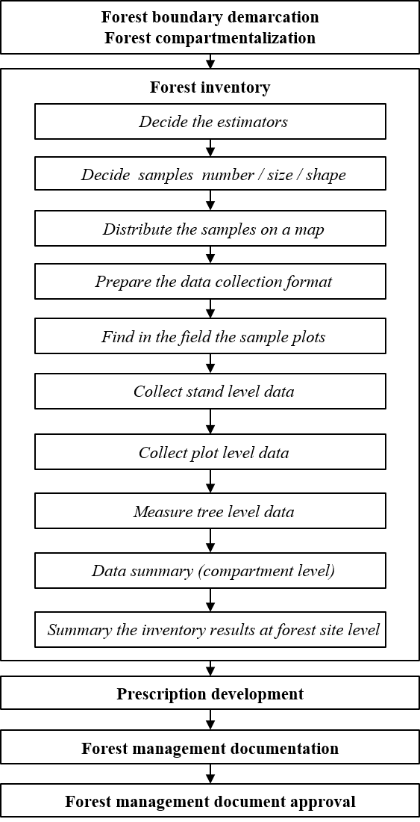
Forest resource assessment work flow

Slide 51
Step 3: Plot selection / Sampling design
Plot type / shape
In forest inventories, the independent observation unit is plot. The shape of a plot in forest inventory could be circular, square or rectangular/strip plot. Most relevant characteristics when comparing circular, square, rectangular/strip plots are:

Slide 52
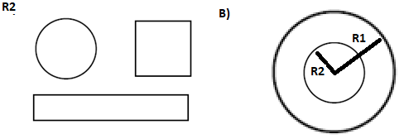
A) Various plot shapes, B) example of circular nested sub-plots

Slide 53
Nested sub-plots:
Sometimes in fixed area plots a large number of small trees may enter. Thus, using a set of sub-plots of different sizes for different size (diameter) classes might be a solution. Not only for trees, but also used for litter and soil observation purposes. Nested plots can be designed for all plot shapes.

Slide 54
Plot size
The number and size of the sample plots required will vary based on how variable the site is, and how precise you need the data to be. For measuring tree dimensions, approximately 15-20 trees in a sample plot is recommended.
Sample plots of various sizes can be established based on the following dimensions. On sloping ground, all distance measurements should be horizontal.

Slide 55
Slope correction
Results from forest inventories are area-related; examples are volume/ha, basal area/ha, number of stems/ha. The area to which these measures refer is the map area; that is the horizontal projection of the terrain into the map plane. If we lay out a circular sample plot with a defined radius on the slope, the projected area in the map plane will be different. This is obviously not desired but if we wish to make an extrapolation of the per-plot observation to the per hectare observation, then all related areas must refer to the same reference system, and that is the map plane.

Slide 56
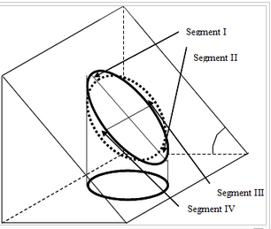
diagram showing an area of reference and projected area into the map plane on a sloping terrain (Kleinn et al 2002).

Slide 57
Determine sample number
In order to determine the sample size, the following equation can be used
Equation : number of sample units

Slide 58
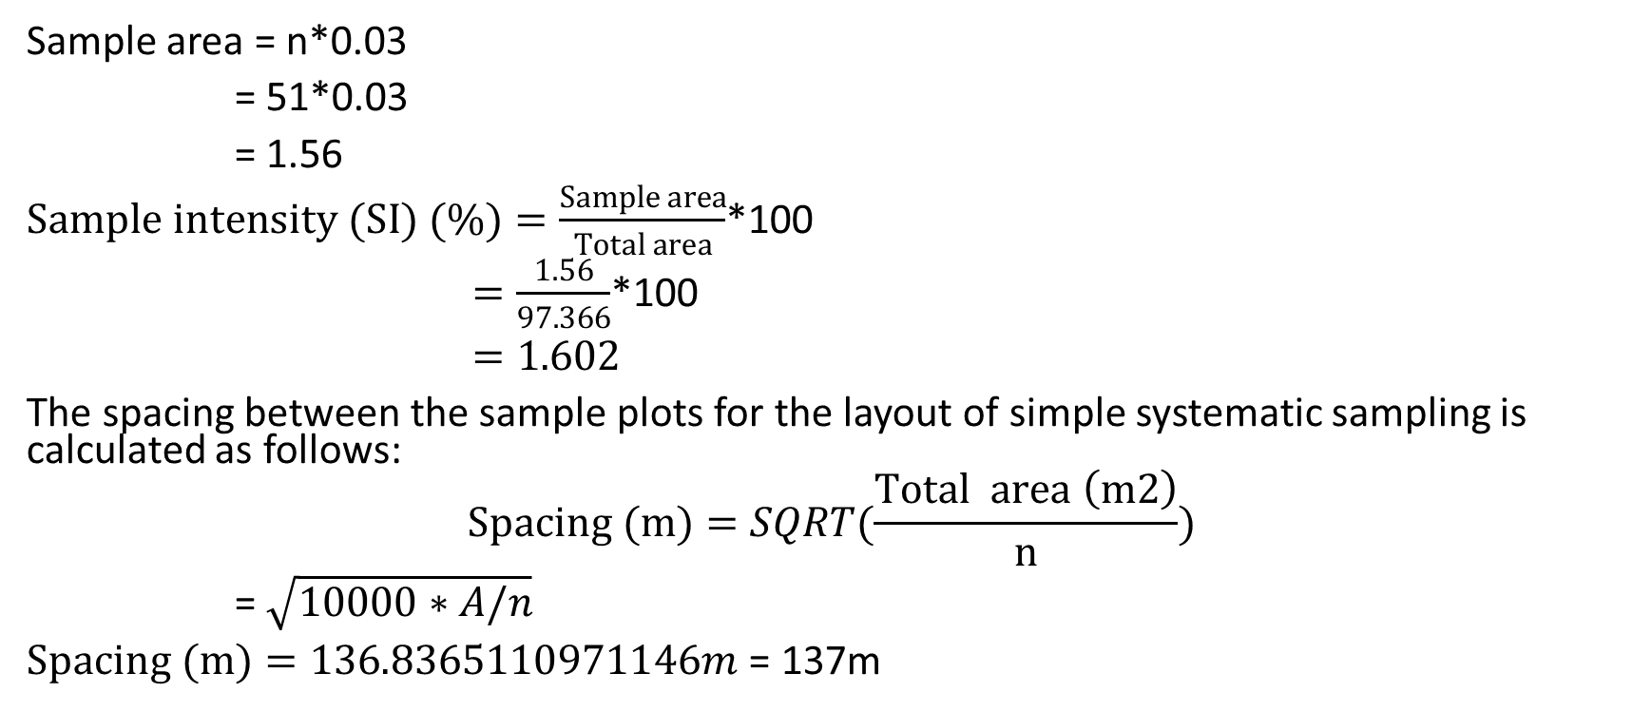
Determining spacing between sample plots
Sample area = n*0.03
= 51*0.03
= 1.56
$Sample intensity (SI) (\%)=\frac{Sample area}{Total area}$*100
$=\frac{1.56}{97.366}$*100
$=1.602$
The spacing between the sample plots for the layout of simple systematic sampling is calculated as follows:
$$Spacing (m)=SQRT(\frac{Total area \left(m2\right)}{n})$$
= $\sqrt{10000∗A/n}$
$Spacing (m)=136.8365110971146m$ = 137m

Slide 59
Decide on the sampling design
Simple random sampling
Stratified random/systematic sampling
Stratification criteria could be:
Forest types,
Ecozones
Site conditions
Political or property boundaries
Tree sociological classes
Species, etc
Systematic sampling

Slide 60
Step 4: Sample plots map and coordinates
Distribution of sample plot
Procedure: Example for sampling design – distribution of sample plot
Coordinates of the sample points

Slide 61
Step 5: Finding plots (cruising plots)
Locating the sample plots in the field can be done using different approaches.
Use GPS
Use GPS to locate plots, if the forest is not dense/closed.
When to use it? The field teams use GPS receivers in field:
to navigate to the starting point of the transect line / plot and reach the starting point for every plot;
to verify the position of the plot after some meters (halfway) the transect line and at the end of the transect line;
to get the coordinate of the reference points (marker position and while accessing to the sampling unit). With the recorded field positions of the plots their actual extension can be applied in a GIS to make overlays with other geographical data as satellite images, air photo, maps, etc., for further analyses.

Slide 62
Practical points in using the GPS
Preparation:
Initialise the GPS (first use only).
Set up units. Appropriate coordinate system and datum should be selected.
Enter the starting point coordinates of the plots into the GPS receiver as waypoints.
In the field
Identify the closest plot starting point (find nearest).
Navigate to the starting point of the first plot to be inventoried (Go To function). Use the compass / navigation page).
Navigate to the next plot starting point (Go To).

Slide 63
Use compass and distance measurement tools
If the forest is densely covered by tree crown, use compass, ranging rod and measuring tape
Find the location of the startining plot (e.g. plot 58 uising GPS)
Adjucts the compass accordining to the bearining (e.g. line 58 to 59). The bearining can be measure on the map. It is east of plot 58 (i.e. 90 degree)
Find the direction of the next plot
From the staning point, earct a line usining rangining rods.

Slide 64
Upload points to a GPS from QGIS
Connect your GPS device to your computer with the USB cable.
Click on the GPS icon in QGIS to open the GPS Tools window.
Open the ‘Import other file’ tab.
Browse to and enter the shapefilethat you want to upload.
Specify what Feature type it is, for example Waypoints.
Enter a Layer name, then the GPX output file location and name with the Save as… button. This is where you will specify the location of the Garmin device and folder location: Garmin\GPX.
You will be able to see these points now from your Garmin GPS device next time you turn it on.
Note that to see your points labelled on your GPS, you will need to have a ‘name’ field –this will be the field that is labelled by default.

Slide 65
The procedure to use the GPS will be
Plan the route to the plots in the camp. If using a car in approaching, mark the point where to leave the car in the GPS as a waypoint. Mark also the other possible waypoints, e.g. a point where to leave the trail.
Use the map to navigate to the point where to leave the car. Check the point with the GPS.
Navigate to the plots by using the map and GPS. Plan the easiest and shortest possible route from one plot to another by considering their reachability.
When arriving to the plot, select an open point where the GPS works well. Collect GPS data 0.5–1 min. The GPS will average the collected data, calculate the current location and display the distance and bearing to the plot centre.
Use the compass / bussoland linear tape to go exactly to the plot centre.
When you have determined the final plot centre, place the GPS device in the centrepoint and start collecting GPS coordinates. Leave the device to collect the coordinates (at least 0.5 hours*).
After making all plot measurements ensure that there is enough GPS observations (xy) Stop collecting the coordinates and save the collected coordinates.

Slide 66
Step 6: Inventory data collection form
Sample table: Field data record form (inventory form) – natural forest
Sample forest inventory form (natural forest
Sample table: Field data record form (inventory form) – plantation forest
Sample forest inventory form (plantation forest)

Slide 67
Forest site: __________________ |  |  |  | Date of data collection: __________________
Forest block: __________________ |  |  |  | Team leader: : __________________
Forest compartment: : __________________ |  |  |  | Data recorder: : __________________
Plot shape: _________________ |  |  |  | Rectangular plot size (m): _______ X _____
Plot area m^{2:} __________________ |  |  |  | Circular plot radius (m): _____________
Land use type: __________________ |  |  |  | Land cover type: __________________
Crown cover (%): __________________ |  |  |  | Elevation
Problems | : 1)_________________: 2)_________________: 3)_________________
Plot number: __________________ |  |  |  | Plot coordinates (x,y)
Slope |  |  |  | X:_________________, Y:__________________
Tree record
Tree nr | Species code | Species |  | DBH (cm) | Height (m)* | Remark
1
2
3
Seedling and sapling record
Nested plot area m^{2:} _____ |  |  | nested plot radius or side:__________________
nr | Species code | Seedling nr | Sapling nr | nr | Species code | Seedling nr | Sapling nr
Sample forest inventory form (natural forest

Slide 68
Forest site: __________________ |  |  |  |  |  | Date of data collection: __________________
Forest block: __________________ |  |  |  |  |  | Team leader: : __________________
Forest compartment: : __________________ |  |  |  |  |  | Data recorder: : __________________
Plot shape: _________________ |  |  |  |  |  | Rectangular plot size (m): _______ X _____
Plot area m^{2:} __________________ |  |  |  |  |  | Circular plot radius (m): _____________
Land use type:________________ |  |  |  |  |  | Land cover type: __________________
Crown cover (%): ___________ |  |  |  |  |  | Elevation:
Problems |  |  | : 1)_________________: 2)_________________: 3)_________________
Plot number: __________________ |  |  |  |  |  | Plot coordinates (x,y)
Slope: |  |  |  |  |  | X:_________________, Y:__________________
DBH class |  | Number (tally per DBH class) and species
min DBH | Max DBH | Species 1 |  |  | Species 2 |  |  | Species 3 |  |  | Species 4 |  | Species 5
Seedling
Sapling
10 | 12
12 | 14
14 | 16
16 | 18
18 | 20
20 | 22
Sample forest inventory form (plantation forest)

Slide 69
Sample tree for height
Nr | Species code | Species |  | DBH (cm) | Height (m)* |  | Nr | Species code | Species |  | DBH (cm) | Height (m)*
1 |  |  |  |  |  |  | 6
2 |  |  |  |  |  |  | 7
3 |  |  |  |  |  |  | 8
4 |  |  |  |  |  |  | 9
5 |  |  |  |  |  |  | 10
Sample forest inventory form (plantation forest)

Slide 70
Step 7: Tree level data collection
Tree level data collection – DBH and height

Slide 71
At each plot, tree level data are to be collected including
dbh of tress (above 10cm dbh) and number of seedlings and/or saplings. These are collected for each tree species, and
the number of seedlings and sapling are counted and recorded according to each species and this is usually done in the nested plots.
Height of trees (sample trees)

Slide 72
Procedure: DBH measurement (Source (Forest assessment and monitoring.html)
????

Slide 73
What does DBH mean for trees?
DBH = Diameter at breast height. Diameter at breast height, or DBH, is the standard for measuring trees. DBH refers to the tree diameter measured at 1.3 m above the ground.

Slide 74
Tree level data collection – Height
Why tree height is needed to be measured?
Total height: the distance between the ground and top of the tree.
Bole height: the distance between the ground and the crown point.
Merchantable height: the distance between the ground and the terminal position of the last useable portion of the tree stem.
Stump height: the distance between the ground and the position where a tree is cut.
Merchantable length: is the distance between the top of the stump and the terminal position of the last useable portion of the tree stem.
Dominant height: is the average height of 100 thickest trees per hectare.

Slide 75
Tree cross-sectional area estimation
If the cross-section of a tree is determined using the diameter at breast height, then it is called basal area. It is denoted by “g”.
Basal area is commonly expressed in square meter (m²)
Importance of basal area measurement:
The sum of the basal areas of all trees in crop is a useful measure of stocking.
In a uniform plantation of a single species volume is closely related to basal area.

Slide 76
Step 8: Tree and stand parameters summary
The general procedure for summarizing the compartment level data is given in the appendix
The detailed forest inventory data is used to generate forest compartment level information which will be the bases for the prescription development and monitoring of the compartments.
The summary should include average DBH, average total height, dominant height, basal area, density (number of trees), volume, biomass and carbon stock. shows a sample stand parameter table.

Slide 77
Step 8: Tree and stand parameters summary
The general procedure for summarizing the compartment level data is given in the appendix
If the stand is composed of more than one species, the tree parameters should be recorded for each species.
In case of natural forest, the year of establishment will be “NA” (not available) unless there was enrichment planting done in the forest.
The compartment level summary table should include at least the following information: compartment id, area in ha, species, year of planting (if plantation forest), age at the time of forest inventory (also for plantation), average DBH, average height, dominant height, number of trees per ha (N), basal area (G), volume per ha (V), total number of trees, total volume, biomass, carbon stock and remark.

Slide 78
Sample compartment stand parameters (year only for assisted regeneration)
Comp id | Species | Year* | Regeneration types | DBH cm | DOMH m | N/ha number | V (m³)ha | Biomass Tons / ha | Carbon stock / ha
1a | Cupressus lusitanica | 2010 | Plated | 21 | 14.5 | 701 | 245 | 1.2 | 0.2
1a | Afrocarpus gracilior | 22015 | planted | 10 | 5 | 545

Slide 79
Sample compartment stand parameters (year only for assisted regeneration)

Slide 80
Step 9: Site level inventory data summary
The compartment level data can be used to develop a site level information. The compartment level data can be used to generate thematic maps and area summaries by the selected attributes. The following are examples of site level data that can be generated from compartment level data:
land use types
land cover types
species types
age class

Slide 81
Relating inventory summary with forest compartment spatial data
The summary of the forest inventory generally contains first compartment level information about the age, average DBH, average height (total, bole, dominant height), density (number of trees per ha), volume per tree, biomass, and carbon stock/ha. The hectare level information can be used to develop the compartment level information. This requires the compartment’s area, which the attribute of the compartment.
The field observation at commitment and level should summarized and integrated with the compartment. Example of such information includes, soil depth, stoniness, problem (fire, grazing, illegal tree cutting, disease, etc). The foresters furthermore prepare a prescription/activity for each compartment to be undertaken during the planning period. Foresters manage the information about already performed activities for each compartment. Example of activities in forestry are site preparation for planting, planting, weeding, slashing, pruning, thinning, clear felling, guarding, conserving, etc.

Slide 82
Relating inventory summary with forest compartment spatial data
The inventory summary data has temporal aspect, because that forest inventory is under taken at certain interval under normal condition (e.g. every 5 or 10 years). The historical data/information about forest compartment is required for different purposes, therefore, the data should be properly managed to allow analysis seamlessly. Similar to the forest inventory data, the forest activities (planned / performed) vary temporally and spatially.
The above forest compartment related information should be managed in a database. The database of the forest compartment can be used to develop forest site level information.

Slide 83
A forest compartment
compartment (vector layer)
the tree level inventory summary at compartment and species level
the forest stand/compartment field/site summary
planned activities
performed activities
These tables are logically related, and can be managed in a geo-database (e.g. ArcGIS, postgreSQL).
Activity: 1) Discuss the conceptual and logical design of the above tables in any DBMS, 2) create a template geo-database to manage the proposed database, 3) create a model to develop information at forest site level, 4) publish the thematic maps in ArcGIS/QGIS (forest compartment map, species map, proposed forest activities, etc.)

Slide 84
Forest inventory analysis: tree and stand parameters
(Density, basal area, volume, biomass, carbon stock)

Slide 85
Sample table: compartment level summary of inventory data
The forest inventory should be summarized at compartment level. The summary should include average DBH, dominant height, basal area, density (number of trees), volume, biomass and carbon stock. If the stand is composed of more than one species, the tree parameters should be done recorded for each species.

Slide 86
Compartment stand parameters (year only for assisted regeneration)
Comp id | Species | Year* | Regeneration types | DBH cm | DOMH m | N/ha number | V (m³)ha | Biomass Tons / ha | Carbon stock / ha
1a | Cupressus lusitanica | 2010 | Plated | 21 | 14.5 | 701 | 245 | 1.2 | 0.2
1a | Afrocarpus gracilior | 2015 | planted | 10 | 5 | 545

Slide 87
Mean and sum of stock, basal area and volume of selected compartments according species
Comp | Area (ha) | species | Number |  | Under story |  |  |  |  | Main story |  |  |  |  | Emergent |  |  |  |  | Total Compartment
 |  |  | Seed. | Sap. | N | G | V | DBH | H | N | G | V | DBH | H | N | G | V | DBH | H | Ns | Gs | Vs
1b | 8.16 | Eucalyptus globulus
1d | 33.5 | Eucalyptus globulus
2a | 25.8 | Eucalyptus globulus
2b | 18.1 | Eucalyptus globulus
2b | 18.1 | Juniperus procera

Slide 88
Compartment level prescription
for the plan period should provide detailed information (task of the foresters). The table contains the following information: Compartment id, priority, prescription type, required man-days, output (e.g. in case of harvesting volume, in case of pruning number of trees, in case of planting number of seedling)
Compartments that should be treated within the plan period (from year – to year) according to compartment and prescription type

Slide 89
Compartments that should be treated within the plan period (from year – to year) according to compartment and prescription type
Comp | Prescription | Priority | Activity area (ha) | Comp area (ha) | Man days | output

Slide 90
Forest zoning
In of this lecture material, the forest zoning has been described in detail. A forest are is divided into different zones based on the objectives of the forest development / project under consideration. The forest zoning requires various spatial and non-spatial data, and criteria for the zoning. The forest organization / bureau/ project defines the objectives, and the team composed of different experts develop the criteria . The criteria is normally developed through literature review and experiences from similar areas.

Slide 91
Activity: Forest zoning
Tasks: Divide the forest site into different zones using:
common criteria for conservation forest, production forest, and soil and water conservation
land capability analysis (not suitability analysis, refer to FAO Manual for wtareshed management and the soil and water conservation guideline of Ethiopia).
the database you created I . Enrich the design of this to address the forest zoning information requirement. In your designer, you may consider common physical data such as slope, elevation, river, road, etc
Deliverables: 1) the database and brief report on the design of the databse, and 2) Published the thematic maps related with forest zones (ArcGIS / QGIS)
Activity type: group

Slide 93
Forest road network mapping

Slide 94
Uses of forest roads
Forests are the vital sources of natural resources for mankind. Forests are the home to various forms of life and serve as a habitat to numerous animals and plants. Forests also serve an essential role in maintaining the ecological balance of the earth. Forest road mapping is an important tool that enables us to maintain, protect and manage forest resources.
Forest road mapping is the process of developing a detailed map of forest roads that help to understand the location, condition and usage of forest roads. Forest road mapping has significant advantages in terms of forest management, protection and conservation. Mapping forest roads help in identifying the location of fire break lines, escape routes, and entry points that enable the forest officials to react quickly in case of any natural disasters like wildfires. Forest road mapping also enables forest officials to monitor and regulate the movement of vehicles that enters the forest for timber harvesting or hunting.

Slide 95
Uses of forest roads
Forest road mapping also helps in the proper management of biodiversity. With the detailed map of forest roads, forest officials can identify the areas that need special attention in terms of biodiversity conservation. They can restrict entry to such areas or can implement special measures to protect those areas from human intervention. Efficient forest road management also helps sustain the natural habitats of various rare and unique species.
In addition to ecological benefits, forest road mapping also has economic significance. Forest resources such as timber, non-timber produce, and other essential goods are often transported through forest roads. The efficient mapping of forest roads helps in minimizing the transportation time of goods, which in turn reduces the transportation cost. Forest road mapping also helps forest officials to control and regulate illegal logging activities, enabling the forest authorities to safeguard against corruption and illegal activities that can reduce the overall revenue of the forest department.

Slide 96
GIS and Remote Sensing for forest road planning
When planning and surveying a forest road, the use of aerial photographs facilitates the location of forest roads as one may get some ideas about possible routes in the office by viewing the pictures through a stereoscope and unacceptable variants can be disregarded.
In addition Global Information Systems are now more widely available. Therefore, the amount of labour and time consuming road survey work on the ground can be reduced considerably.
However, field reconnaissance and field checks are required in any case to ensure that something has not been missed, and to arrive at an optimum road location.

Slide 97
Road types
When creating a road layer (as vector) in the GIS database, attributes might be added for road type, and road surface.
Within a forest road-network, one can classify roads based on different criteria

Slide 98
Road types
According to their position:
main valley roads
secondary valley roads
slope roads
feeder roads
mountain ridge roads
According to the construction:
gravelled roads (mechanically stabilized roads)
chemically stabilized roads
roads with bituminous or oiled surface
According to the intended use:
truck roads
tractor roads
purely opening-up forest roads
access roads
multiple use forest roads
According to importance:
main roads (permanent roads and all-weather roads)
secondary roads, feeder roads (seasonal roads)

Slide 99
The forest road network feature dataset
The forest road network mapping requires common feature classes including road, culverts, bridges, and location of source for road maintenance /construction material. The roads attribute may include road type, use, surface material, use, and staus (functioning, under construction, planned, damaged, abandoned), length, width, responsible, etc. The bridge and culvert layers’ attribute may include type, use, width, status, material of construction, year of construction, etc.
These feature classes of the road network dataset can be created / updated using various sources such as very high-resolution imagery, field survey, field observation, and exposing documents. The layers are usually created through common methods such as digitization.
During the layers creation, the topology rules should be respected. Some of the topology rules include: over- / under-shoot, connectivity, and duplication,

Slide 100
Activity: road network data
Task: create a forest road network dataset for a forest project area
Database: use the database used in the previous activities
Deliverables: 1) The forest database with road-network dataset add, 2) thematic maps published for A) forest compartment, and B) forest zoning/land cover

Slide 101
Trees outside forest (TOF) mapping
This unit covers issues related with TOF mapping from GIS and RS perspective views.
Students are advised to refer to the book named “Techniques/Methodologies Used to Map TOF/Agroforestry”.

